Slide 1



Divisão de
Nutrologia
ESPEN
Practical guideline on clinical nutrition in
Acute and Chronic Pancreatitis
Ribeirão Preto
2024

Slide 2
Divisão de
Nutrologia
ESPEN Practical guideline on clinical nutrition in Acute and Chronic Pancreatitis
Marianna Arvanitakis Dptm of Gastroenterology, Universite Libre de Bruxelles, Brussels, Belgium
Johann Ockenga Dptm of Gastroenterology, Klinikum Bremen Mitte, Bremen, Germany
Mihailo Bezmarevic Clinic for General Surgery, University of Defense, Belgrade, Serbia
Luca Gianotti School of Medicine and Surgery, University of Milano-Bicocca
Zeljko Krznaric Dptm of Gastroenterology, School of Medicine, Zagreb, Croatia
Dileep N. Lobo Nottingham University Hospitals NHS Trust and University of Nottingham, UK
Christian Loser Medical Clinic, DRK-Kliniken Nordhessen, Kassel, Germany
Christian Madl Division of Gastroenterology, Vienna, Austria
Remy Meier AMB-Praxis-MagenDarm Basel, Basel, Switzerland
Mary Phillips Dptm of Nutrition and Dietetics, Royal Surrey County Hospital, Guildford, UK
Henrik Højgaard Rasmussen Centre for Nutrition and Bowel Disease, Aalborg University, Denmark
Jeanin E. Van Hooft Dptm of Gastroenterology, Leiden University Medical Center, Leiden, the Netherlands
Stephan C. Bischoff Institute of Nutritional Medicine, University of Hohenheim, Stuttgart, Germany
Clinical Nutrition, Vol 43, Issue 2, p.395-412, February 2024
https://doi.org/10.1016/j.clnu.2023.12.019

Slide 3
Divisão de
Nutrologia
Abbreviations
ACS acute compartment syndrome
ANP acute necrotizing pancreatitis
AP acute pancreatitis
CP chronic pancreatitis DXA dual-energy X-ray absorptiometry EN enteral nutrition IAH intra-abdominal hypertension IAP intra-abdominal pressure MCT medium chain triglycerides ONS oral nutritional supplements PEI pancreatic exocrine insufficiency PERT pancreatic enzyme replacement therapy
PN parenteral nutrition PPI proton pump inhibitor RCT randomized controlled trial SIBO small intestinal bacterial overgrowth

Slide 4
Divisão de
Nutrologia
1. Introduction, 2. Methodology
3. Acute pancreatitis (Fig. 1)
4. Chronic pancreatitis (Fig. 5)
Mild to moderate disease (Fig. 2)
Nutritional screening
Oral feeding with low fat soft diet
EN in case of intolerance to oral feeding
Severe disease (Fig. 3)
PN in case of intolerance of EN
Substances not recommended in severe disease
Severe disease with necrosectomy (Fig. 4)
Oral feeding with low fat soft diet
EN in case of intolerance to oral feeding or insufficiency of oral feeding
Complementary or exclusive PN in case of intolerance to EN
Measurement of intra-abdominal pressure
Open abdomen
Diagnostics
Evaluation of nutritional status and screening for micro- and macronutrient deficiencies (Fig. 6)
Check for exocrine insufficiency and pancreatic enzyme replacement therapy (Fig. 7)
Diagnosis and management of bone diseases (Fig. 8)
Nutritional management
Oral nutrition (Fig. 9)
Oral nutritional supplements (Fig. 9)
Enteral nutrition (Fig. 10)
Parenteral nutrition (Fig. 10)

Slide 5
Divisão de
Nutrologia
Chronic pancreatitis (Fig. 5)
Diagnostics
Evaluation of nutritional status and screening for micro- and macronutrient deficiencies (Fig. 6)
Check for exocrine insufficiency and pancreatic enzyme replacement therapy (Fig. 7)
Diagnosis and management of bone diseases (Fig. 8)
Nutritional management
Oral nutrition (Fig. 9)
Oral nutritional supplements (Fig. 9)
Enteral nutrition (Fig. 10)
Parenteral nutrition (Fig. 10)

Slide 6
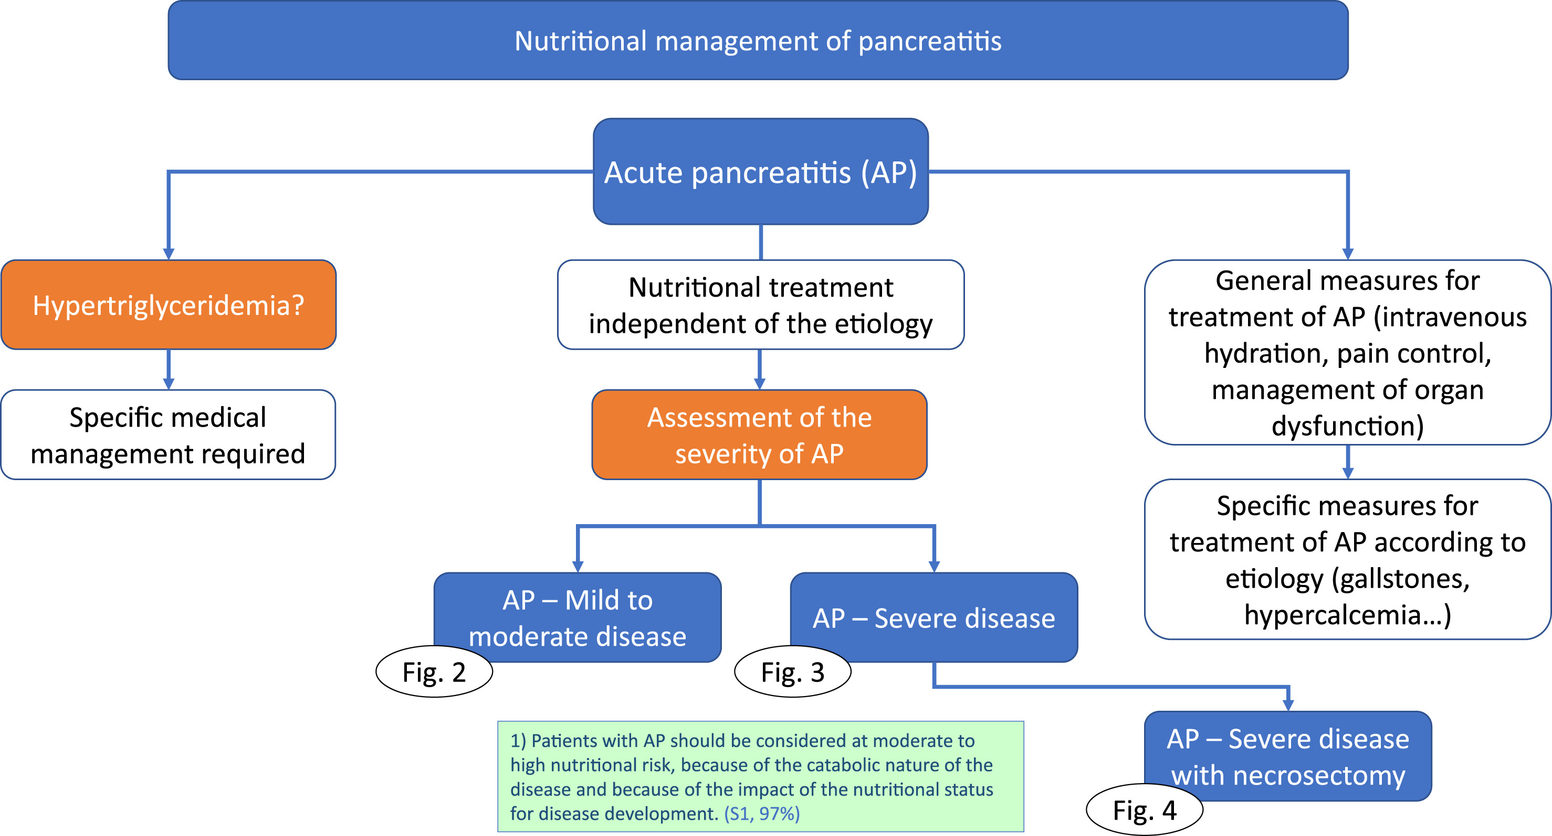
3. Acute Pancreatitis
Fig. 1. Nutritional management of acute pancreatitis. ESPEN, 2024.

Slide 7
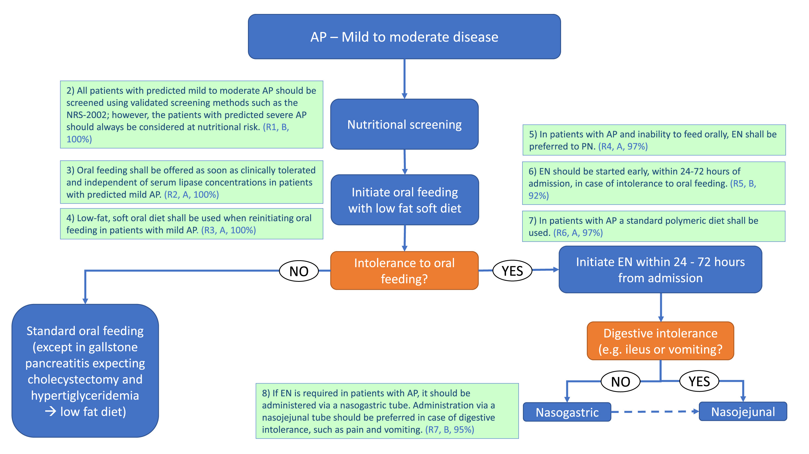
Acute pancreatitis - Mild to moderate disease
Fig. 2. Management of mild to moderate acute pancreatitis. ESPEN, 2024.

Slide 8
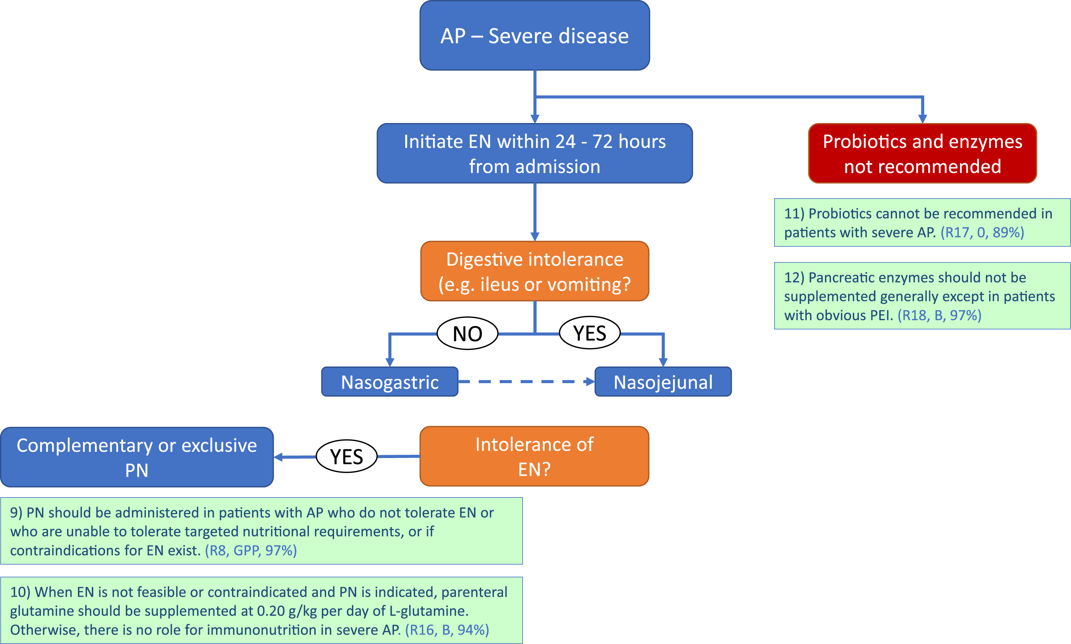
Acute pancreatitis - Severe disease
Fig. 3. Management of severe pancreatitis. ESPEN, 2024.

Slide 9
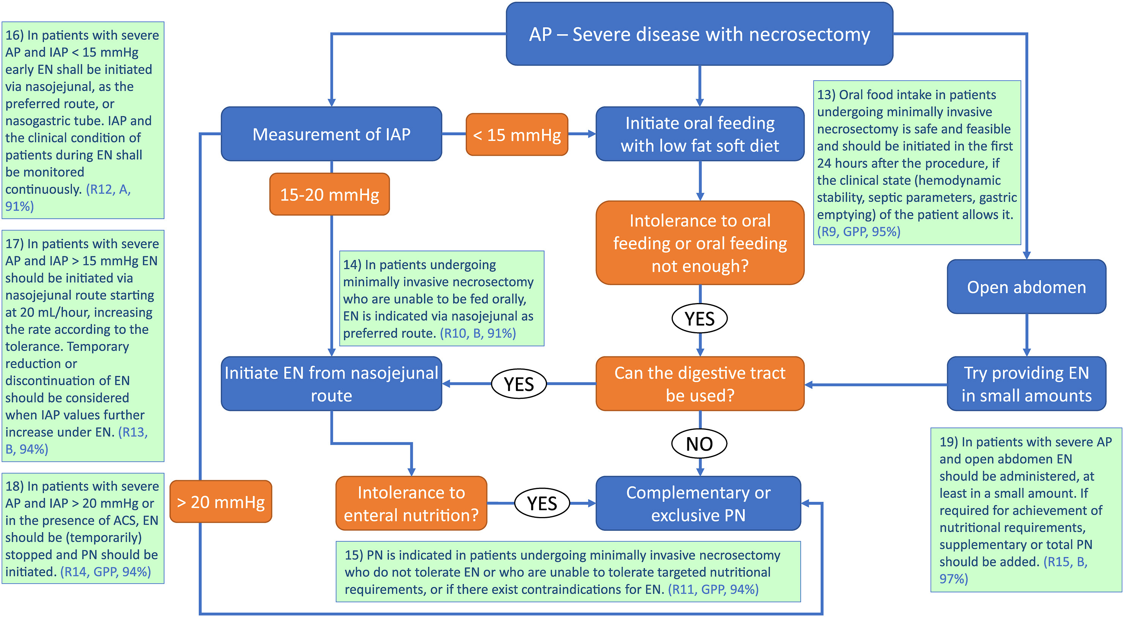
Acute pancreatitis - Severe disease w/ necrosectomy
Fig. 4. Management of severe pancreatitis with necrosectomy. ESPEN, 2024.

Slide 10
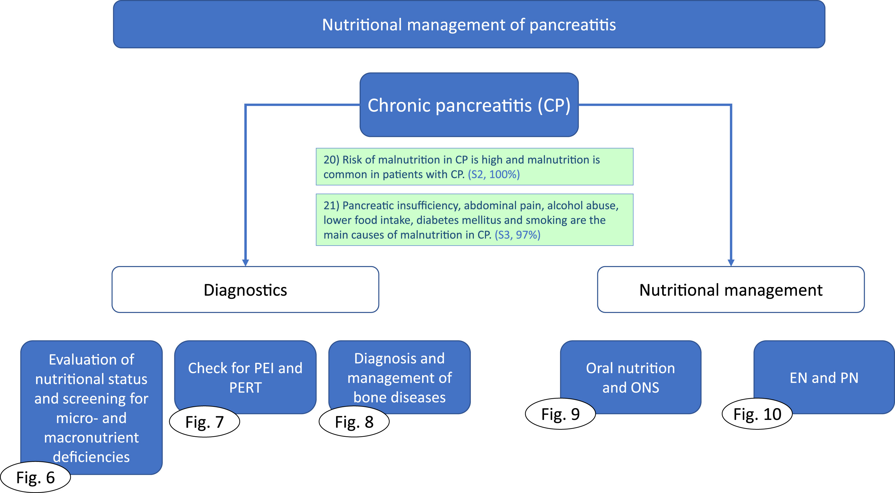
4. Chronic Pancreatitis
Fig. 5. Nutritional management of chronic pancreatitis. ESPEN, 2024.

Slide 11
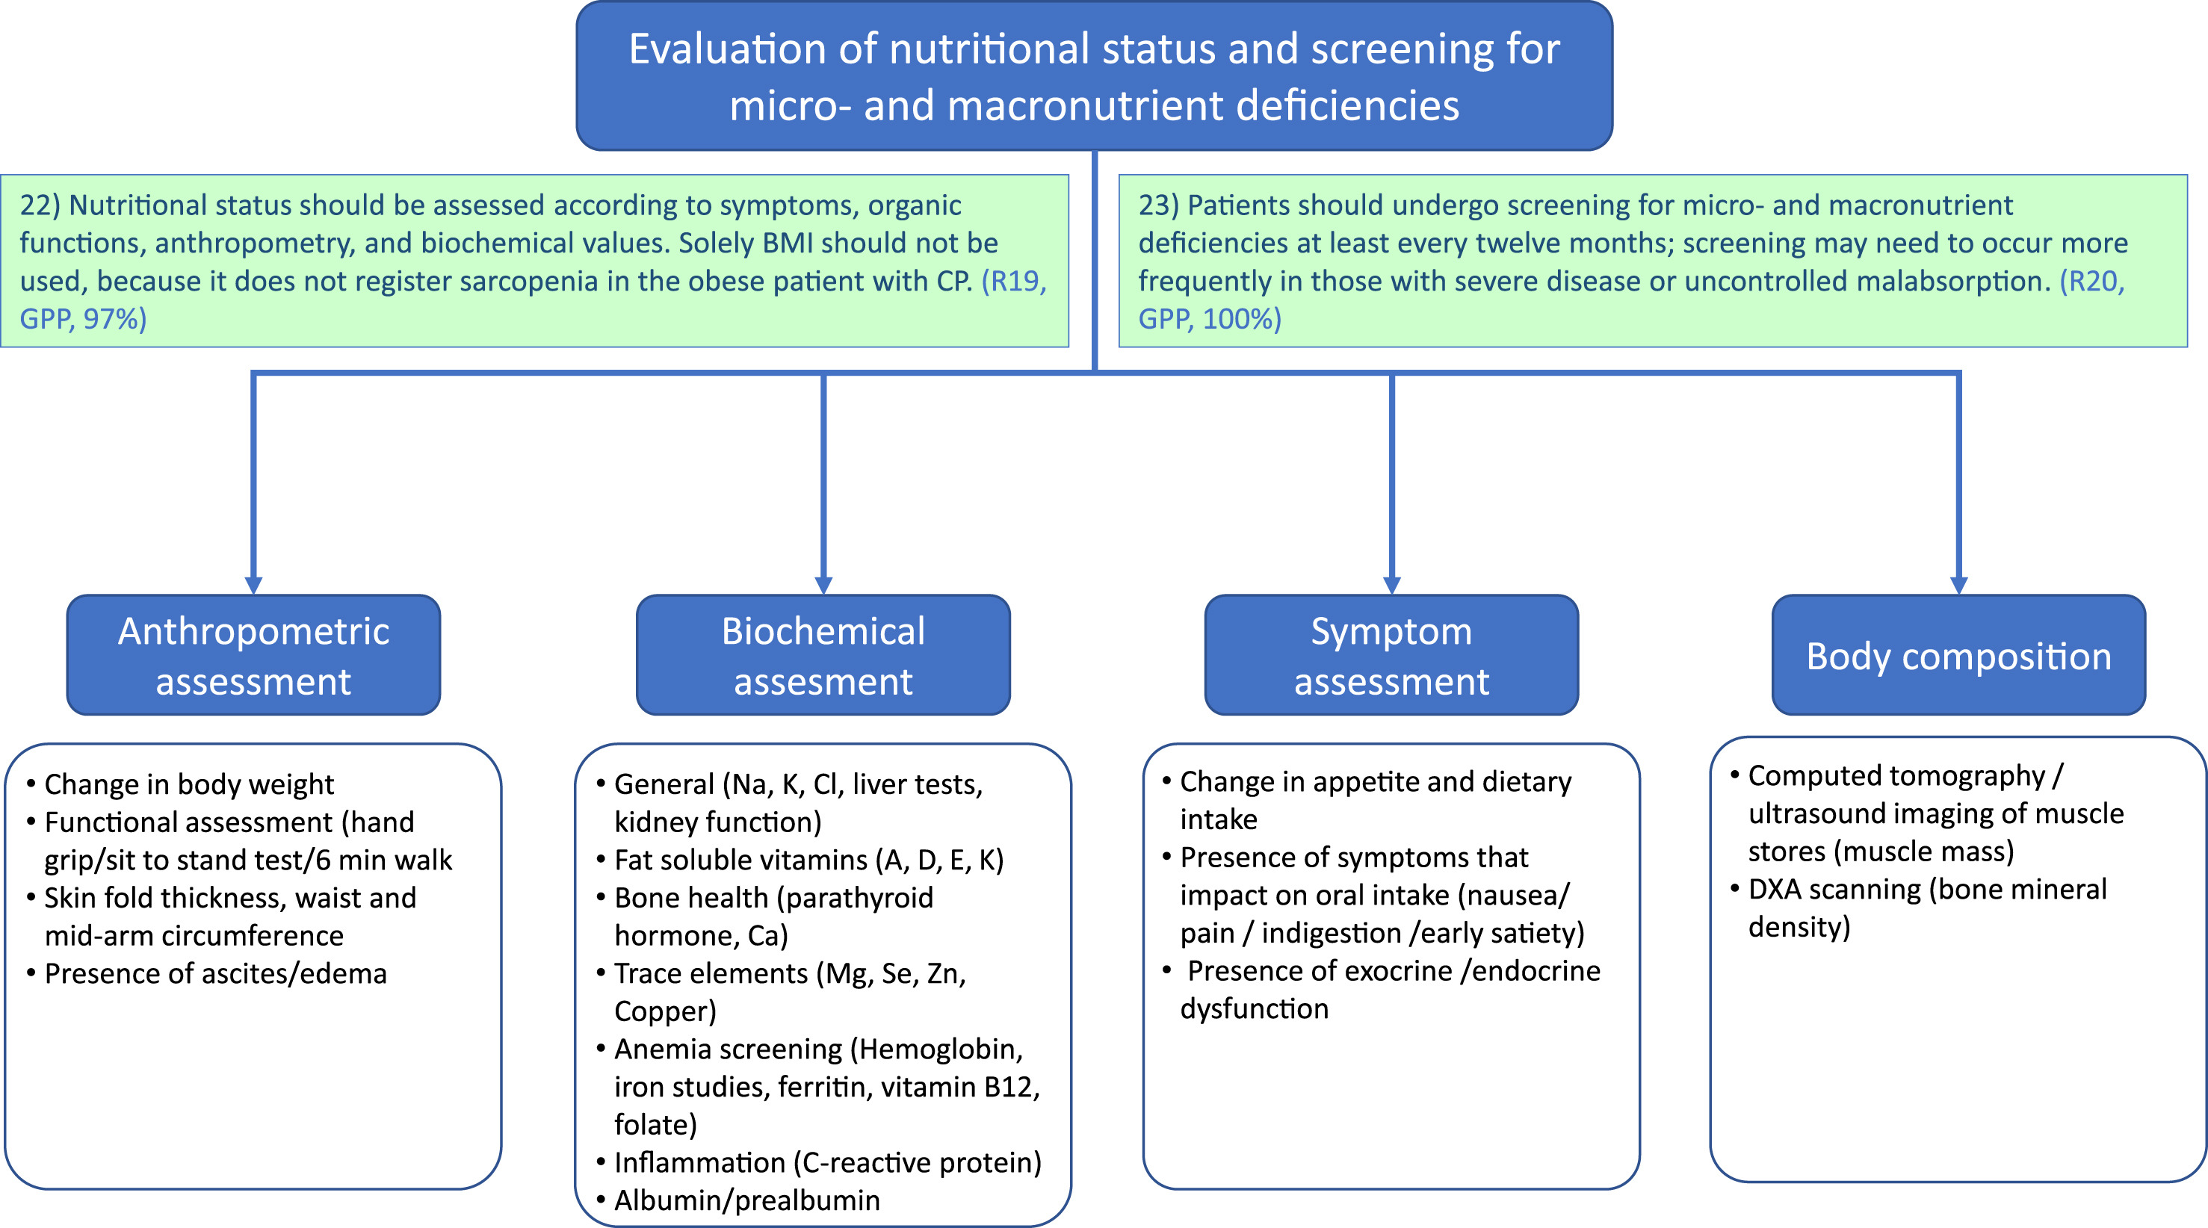
Chronic Pancreatitis Diagnostics
Fig. 6. Evaluation of nutritional status and screening for micro- and macronutrient deficiencies in chronic pancreatitis. ESPEN, 2024.

Slide 12
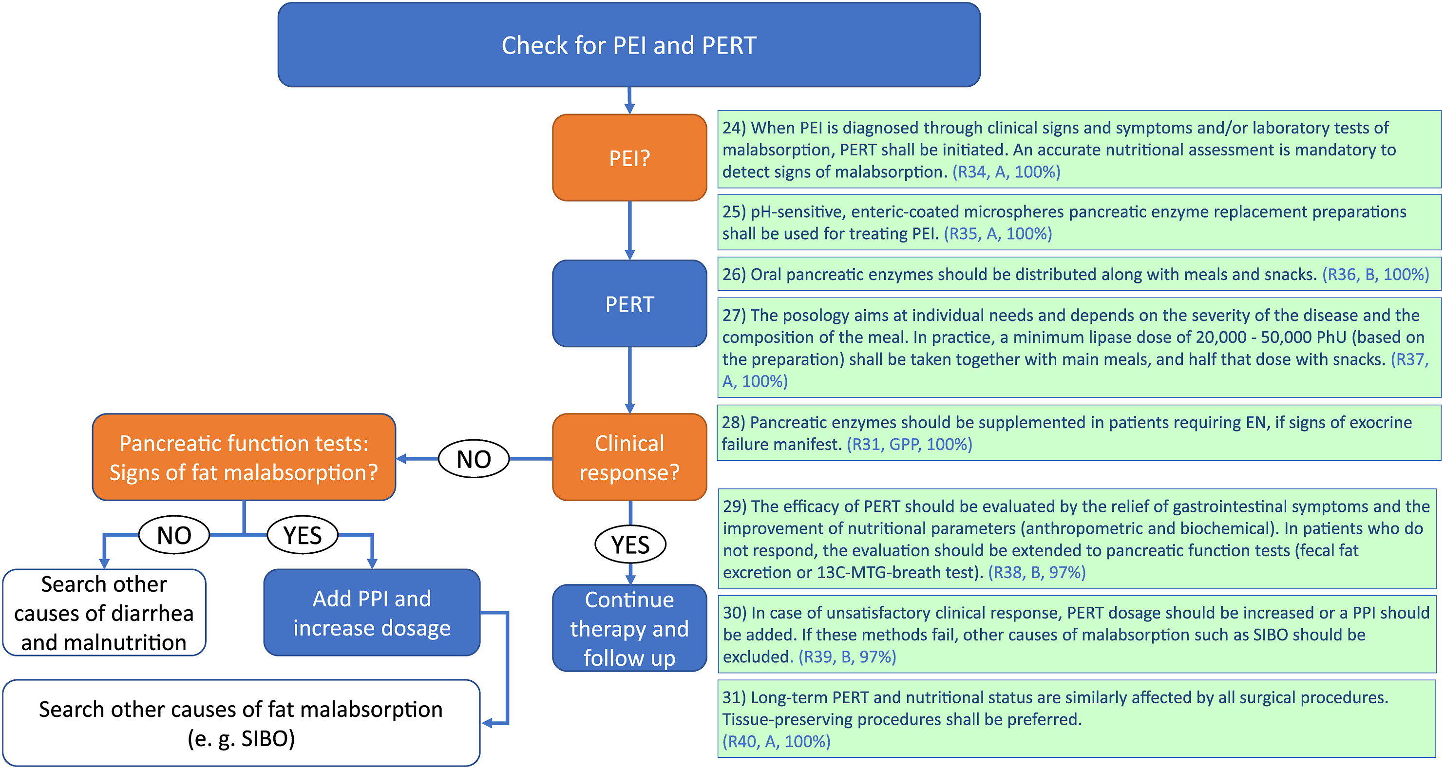
Chronic Pancreatitis Diagnostics
Fig. 7. Check for pancreatic exocrine insufficiency and pancreatic enzyme replacement therapy in chronic pancreatitis. ESPEN, 2024.

Slide 13
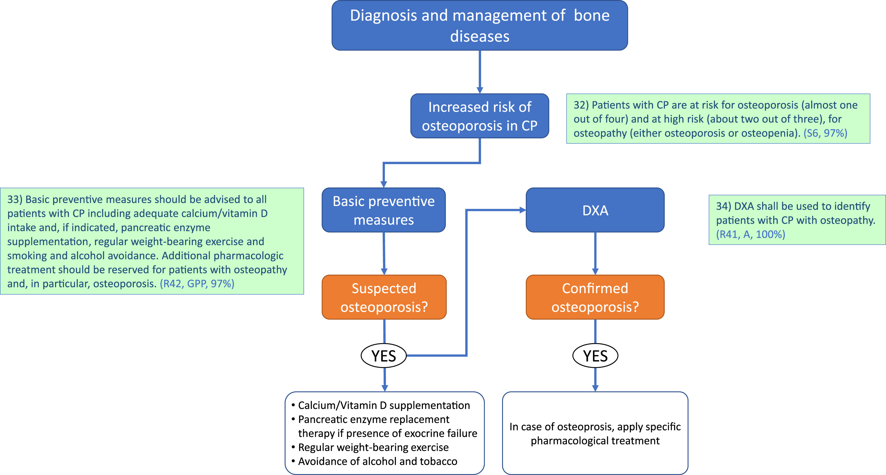
Chronic Pancreatitis Diagnostics
Fig. 8. Diagnosis and management of bone diseases. ESPEN, 2024.

Slide 14
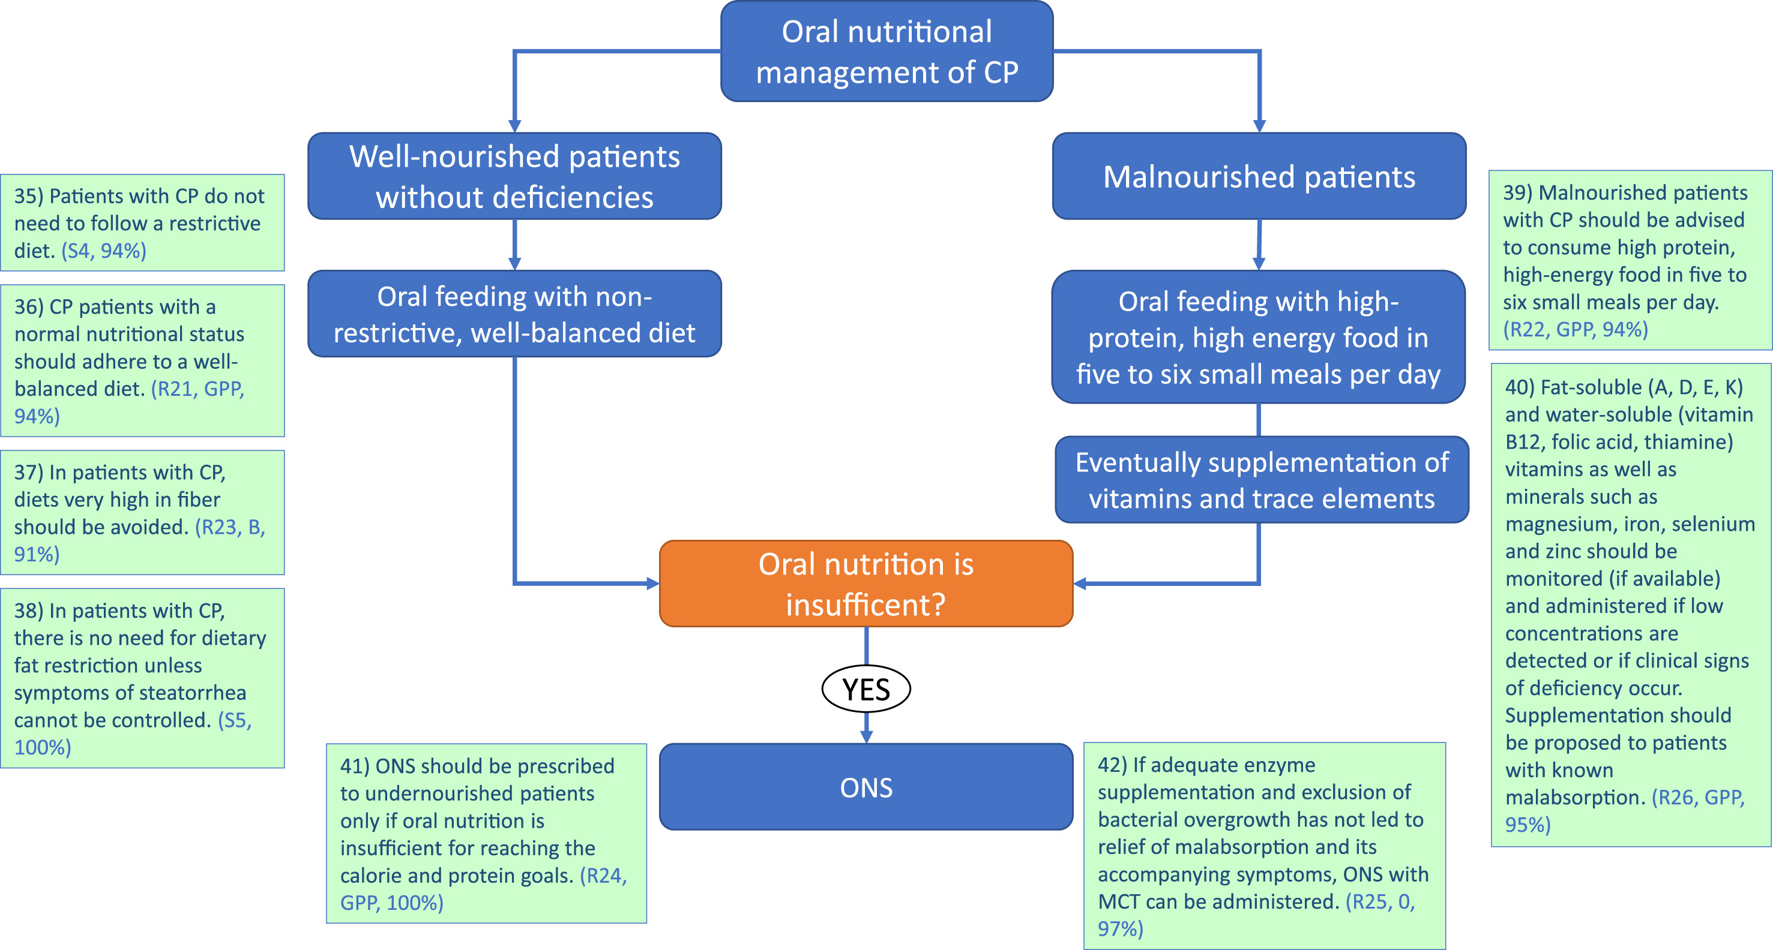
Chronic Pancreatitis Oral Nutritional Management
Fig. 9. Oral nutritional management of chronic pancreatitis. ESPEN, 2024.

Slide 15
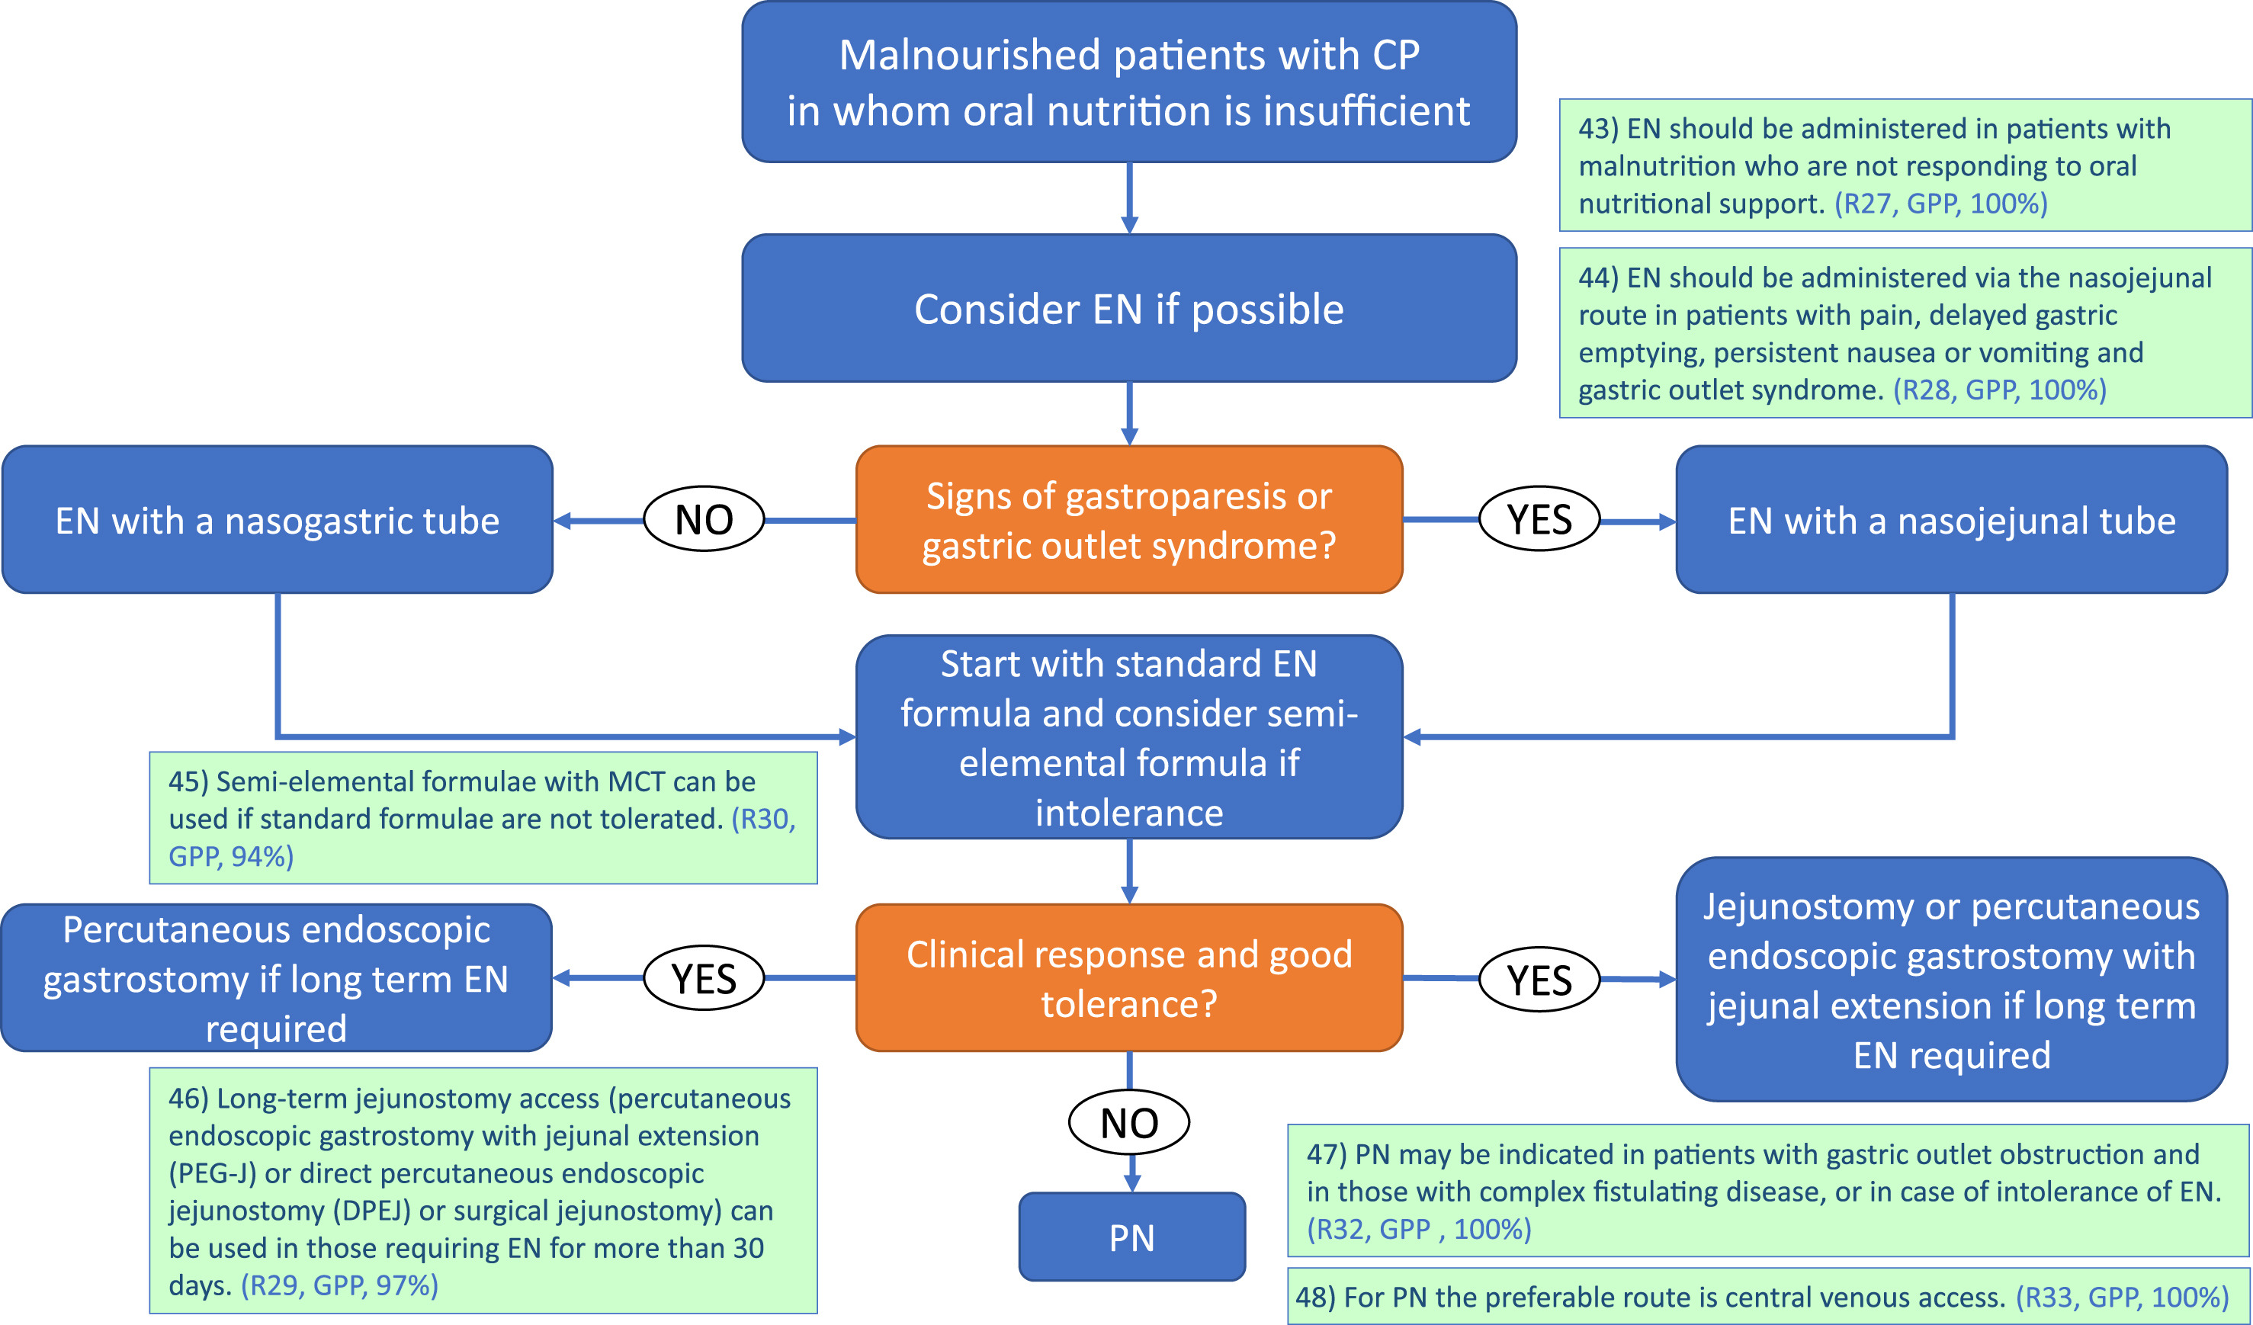
Chronic Pancreatitis Nutritional Management (EN/PN)
Fig. 10. Management of malnourished patients with chronic pancreatitis in whom oral nutrition is insufficient. ESPEN, 2024.

Slide 16
Título

Slide 17
Divisão de
Nutrologia
Obrigado
Ribeirão Preto
2024

